Slide 1
Atomic History
How do we know all this stuff anyway?

Slide 2
Quick Review of Particles
Atoms, Molecules, Compounds and Elements
The Basic Parts of an Atom
http://www.chem4kids.com/files/matter_intro.html

Slide 3
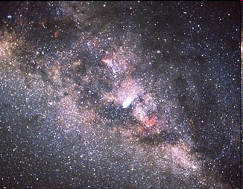
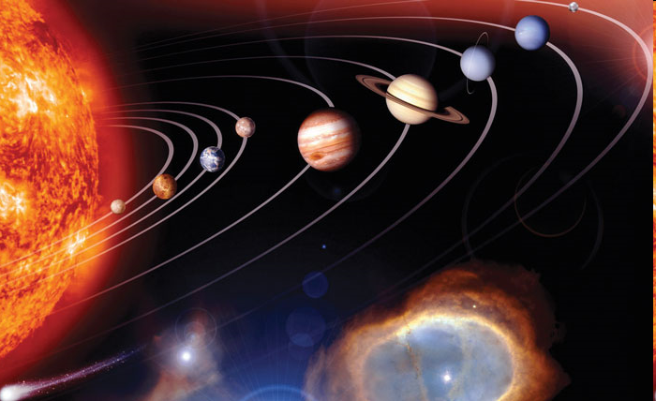
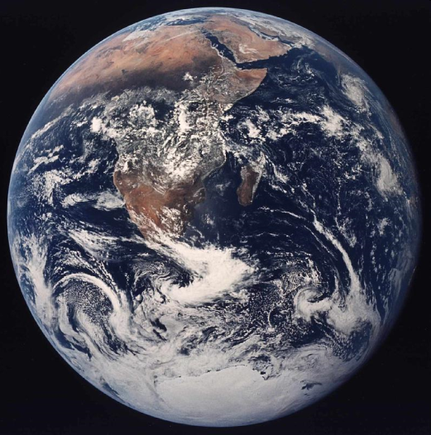
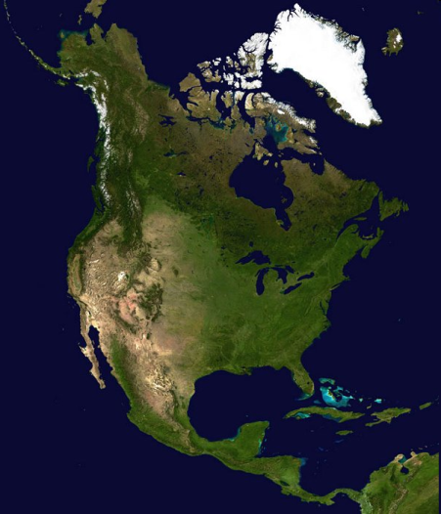
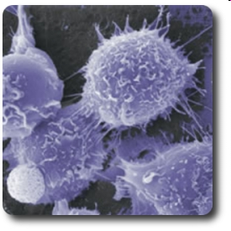
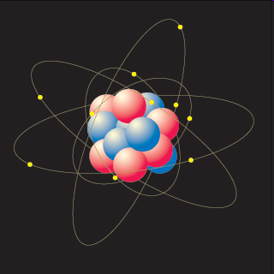
Atoms are too small to see.Right?
Size and Scale Link Universe
Size and Scale Link Atom
There are between 100 billion and 400 billion stars in our galaxy.
About 6,000,000,000 (6 billion) people live on the earth
About 300,000,000 (300 million) people live in the USA
There are about 7,000,000,000,000,000 (7 quadrillion) atoms in one cell.
The average person is made of around 65,000,000,000,000 to 10 100,000,000,000,000( 65 -100 trillion) cells Cells
About 2,500,000 (2 .5 million) people live in Utah

Slide 4
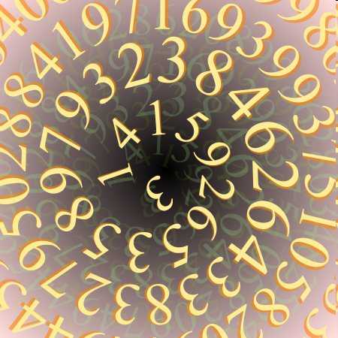
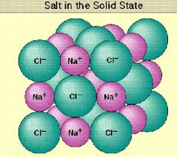
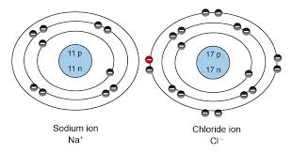
…How could we possibly know so much about them?
If you counted one atom per second, it would take you 221,968,544 years to count all of the atoms in one cell!
Size Scale Example
Investigate:
  1. How many atoms are in a penny?
    20 thousand Billion Billion.
    20,000,000,000,000,000,000,000
    2x10 to 22nd power.
  2. How many atoms = the thickness of aluminum foil?
    50,000
  3. How many atoms are in a grain of salt?
    1.2x10¹⁸ atoms, half of which are sodium atoms. (The other half is chlorine atoms, of course
    12,000,000,000,000,000,000
  .
  Read page 80.

Slide 5
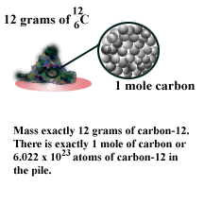
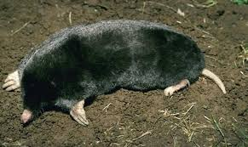
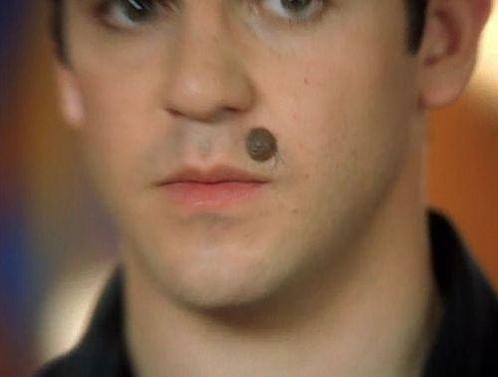

What the heck is a Mole?
    Think of moles as a "chemist's dozen". Just as 12 eggs is a dozen eggs, 6.02 × 10²³ eggs is a mole of eggs. 6.02 × 10²³ molecules of oxygen is a mole of oxygen. A mole is that number of molecules in a substance.

Slide 6
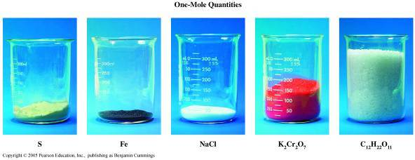
A Mole is a mole but the volume and mass of 1 mole varies from 1 element to the next
  1 Mole of an element or compound is the amount of molecules in that element or compound = to 12 grams of carbon which is Avogadro’s # of 6.022 x 10²³
1 mole = 32 g
1 mole = 55.8 g
1 mole = 58.4 g
1 mole = 294 g
1 mole = 342 g
    See mole jars of salt and sugar.

Slide 7
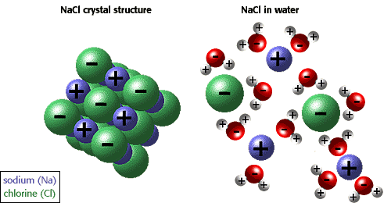
Table Salt in Water

Slide 8
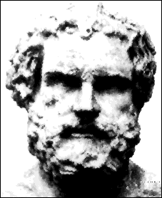
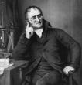
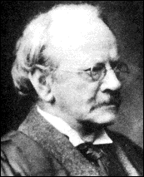
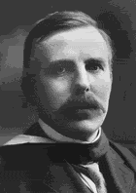
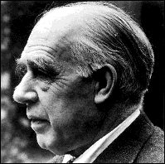
Who are these people?
In this lesson, we’ll learn about the scientists whose quests for knowledge about the fundamental nature of the universe helped define our views about atoms.
Read Text Page 80.

Slide 9
Complete this data table please.
The Atomic Theory Development
Scientist Name | Contribution Detail | Year of Contribution
Democritus
John Dalton
J.J. Thompson
Ernest Rutherford
Niels Bohr

Slide 10
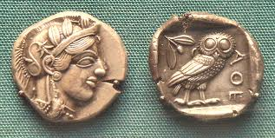
A Greek beginning
This is the Greek philosopher Democritus who began the search for a description of matter more than 2400 years ago.
Scanning Tunneling Microscope 1980’s + other 80’s technology fun.
Democritus proposed the atom around 440 BC. The word “atom” is from the Greek word “atomos” which means “indivisible”.
  He asked: Could matter like the coin below be divided into smaller and smaller pieces forever, or was there a limit to the number of times a piece of matter could be divided?
He concluded that atoms are….
  indivisible .
  too small to see.
  always moving.

Slide 11

After the Greeks
The idea of atoms being the building blocks of matter wasn’t seriously looked at for a long time after the Greeks came up with the idea.
Aristotle who lived from 384-322 BC disagreed about particles being indivisible. Aristotle had a strong influence on what people believed.

Slide 12
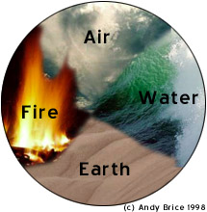
Aristotle
Aristotle and Plato favored the earth, fire, air and water approach to the nature of matter.
Their ideas were persuasive because they were philosophers.
The idea of atoms was buried for approximately 2000 years.

Slide 13
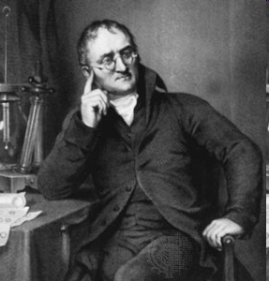
John Dalton (1803)
In 1803, John Dalton reintroduced the idea of atoms when he proposed that all matter is made up of atoms. He created the 1st Atomic Theory.

Slide 14
John Dalton (1803)
His Theory Stated
  1. All matter is made of atoms. Atoms cannot be created, divided, or destroyed.
  2. Atoms of the same element are alike.
  3. Atoms of different elements are different.
  4. Atoms join with other atoms to make molecules and compounds.
In the late 1700’s scientists noticed that elements combine in specific amounts to make substances.
Most of his theory ended up being correct.
However, scientists did later prove that the atom is DIVISIBLE.

Slide 15
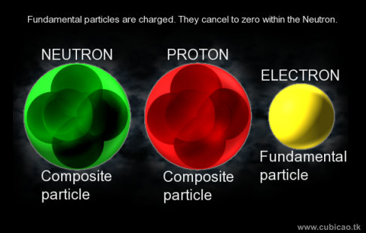
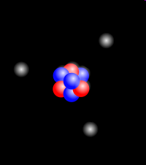
After Dalton
People began to see clues that atoms might be made up of even smaller particles.
We now call these particles protons (+), neutrons (neutral), and electrons (-).

Slide 16
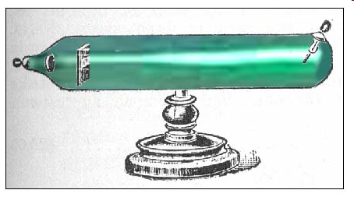
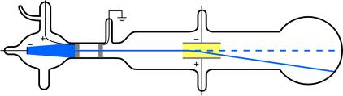
J. J. Thompson (1897)
In 1897, J.J. Thompson discovered the negative particles (electrons) of atoms using a glass tube experiment.
See page 82.
Try Charging balloon

Slide 17
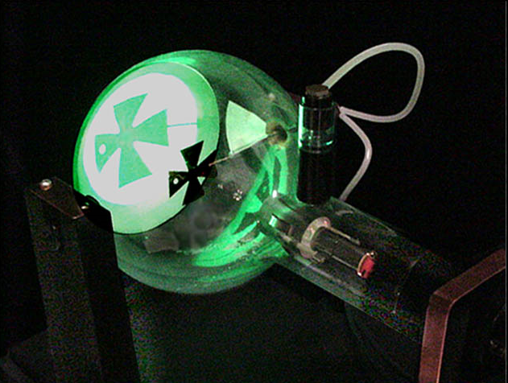
J. J. Thompson (1887)
By sending an invisible beam of matter through a tube connected to electricity, Thompson did several experiments through which he found that:
  Electrons are negatively charged particles in an atom.
  Electrons are attracted to opposite charges.
  Electrons have little mass

Slide 18
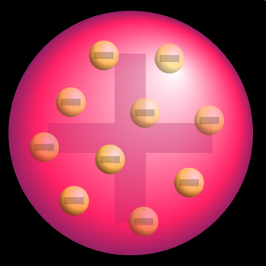
J. J. Thompson (1887)
In 1897 J.J. Thompson created the plum pudding” model of the atom.
See pg. 83 plum pudding explanation.
He thought that negatively charged electrons floated randomly around in a positively charged sphere.
A model is a representation of an object or system. A model is different from a theory in that a model presents a picture of what the theory explains.

Slide 19
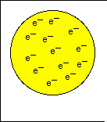
Thompson’s Plum Pudding Model of the Atom
The atom is mostly positive charges material with some small negative particles scattered throughout.

Slide 20
What is a model in science?
It is a smaller or larger than life representation of an object or system.
Are there any problems with using models?
Some models are…
  The Globe
  The Atom Model
  The Cell Model
  The DNA Model
  The Earth Model
  The Eye Model
  The Skeleton Model

Slide 21
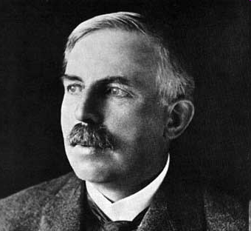
Rutherford (1909)
In 1909, Ernest Rutherford did an experiment called the “Gold Foil” experiment. He proved that there is a positive charged nucleus in the atom.
See page 84

Slide 22
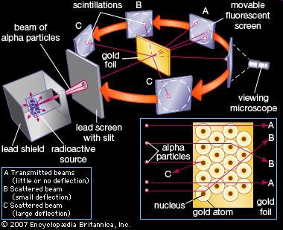
Rutherford (1909 -1911)
Rutherford shot positive particles of matter at a very thin sheet of metal, and was able to record where they hit on the other side of the metal.

Slide 23
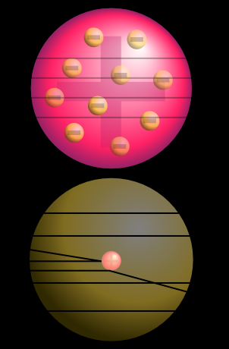
Rutherford (1909 -1911)
The expected results, using the plum pudding model would look like this.
The atom has a nucleus. However, this is what Rutherford discovered.

Slide 24
Rutherford (1909 -1911)
Instead, Rutherford’s results looked like this.
Rutherford’s experiment taught us that:
  Protons are the positive part of an atom.
  Protons are in the center of the nucleus and take up a very small part of the total atom.
  However, the nucleus contains most of the mass of the atom.
  Most of the atom is empty space.

Slide 25
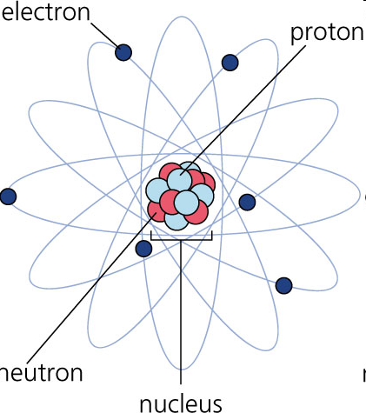
Niels Bohr (1913)
In 1913, Niels Bohr said that electrons orbit the nucleus like planets around the sun and that you can know their location.
This is called the Bohr model.

Slide 26
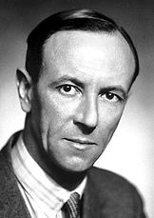
The discovery of the neutron.
James Chadwick discovered the neutron in 1932

Slide 27
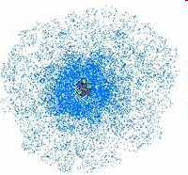
The Modern Atomic Theory
Erwin Schrodinger
Werner Heisenberg
  Helped improve the modern atomic theory.
    For Example – They determined that electrons do not orbit the nucleus in defined pathways. They orbit in levels and form clouds. The exact location of the electron cannot be known.

Slide 28
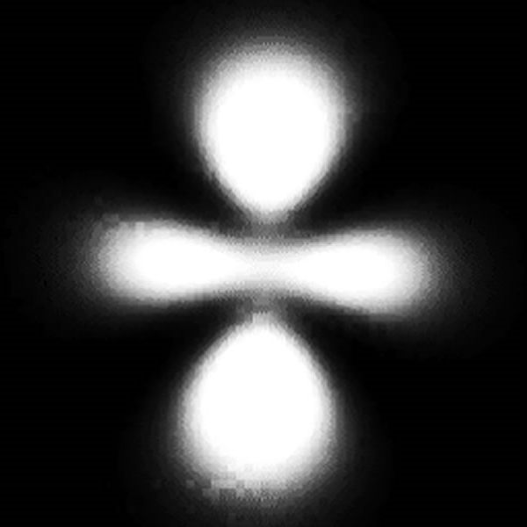
Our Modern Model
Today our model of the atom is one with the nucleus in the center and a “electron cloud” around the nucleus to show the areas where an electron might be found.
Review Video

Slide 29
Problems with using a model atom
There are a few limitations (problems) that occur anytime you try to make a model of an atom.

Slide 30
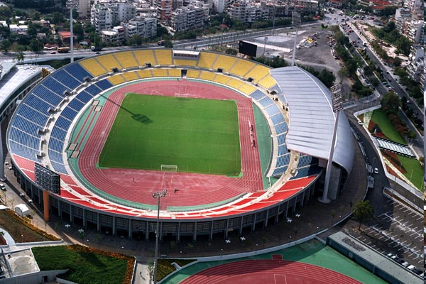


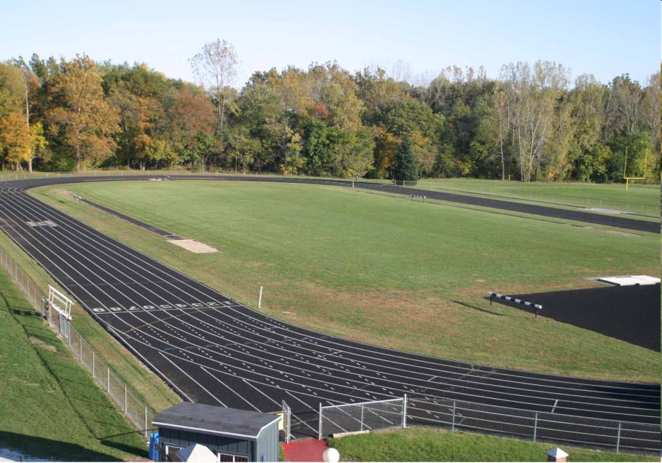
Problems with using a model atom
1- You can’t accurately show the distance between particles in the atom.
  If the nucleus were the size of a bean, the atom would be the size of a football stadium.
  If the nucleus were the size of a tennis ball, the electrons would reach 4 miles out.

Slide 31
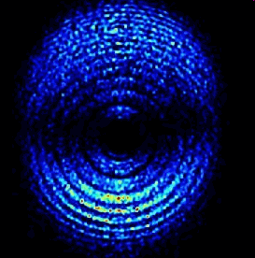
Problems with using a model atom
The motion of electrons cannot be accurately shown in most models.
  Electrons do not move in nice circular orbits around the nucleus, but that is how most models have to show them, because they can’t show the electron movement.
Electron motion video clip

Slide 32
Problems with using a model atom
The size proportion of each atom sub-particle cannot be accurately displayed in models of the atom.

Slide 33
Why are models useful?

Slide 34

Future Models
Our current model of the atom will probably change as we learn more, experiment more, and build on the knowledge of those who came before.

Slide 35
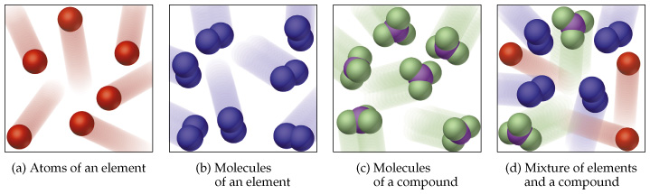
So How Does It All Work?
Atoms build molecules. Molecules build compounds.
For example:
Carbon (C) , Hydrogen (H) and Oxygen (atoms) build sugar molecules (C6H12 O6)
Oxygen atoms (O) build Oxygen gas molecules (O2)
Sodium atoms (Na) and Chlorine atoms (Cl) build salt molecules (NaCl)

Slide 36
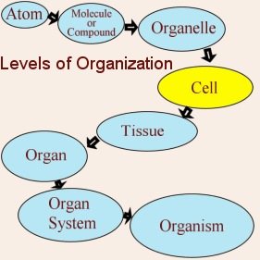
So How Does It All Work?
Let’s add to our knowledge of the levels of organization.
Summary:
Protons + Neutrons + Electrons = Atoms

